Slide 1
Python Reinforcement Project
CHANDRU S DS OCTOBER 2025

Slide 2
Agenda
Data understanding
Data cleaning
Handling missing values
Outliers
Data visualization
Recommendation

Slide 3
Introduction
The project focuses on Exploratory Data Analysis (EDA) of laptop prices to understand the key factors influencing pricing.
The laptop market is highly diverse, with variations in brand, specifications, and features, making it challenging for both customers and sellers to make informed decisions.

Slide 4
Data Understanding
First in data understanding we need to import the CSV file.
The dataset (laptopData.csv) contains detailed information about different laptops, including their specifications, features, and prices. Each row represents a laptop model, while the columns provide attributes such as brand, processor, RAM, storage, GPU, display, operating system, and price.

Slide 5
Data Cleaning
Fixing Rows & Columns
Handling Missing Values
Data type conversion
Checking outliers

Slide 6
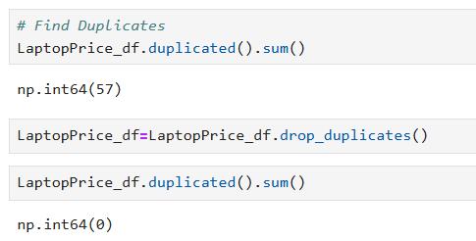
Fixing Rows & Columns
This step ensures the dataset has a clean structure before moving into deeper analysis.

Slide 7
Handling Missing values
Isnull () function is used to find missing values in dataset.
Unique () function and replace the unique values.
Mode is used to fill the missing values in text and category columns.
Mean and Median is used to fill the missing values in numerical columns.

Slide 8
Converting Datatype
Df. to_numeric() is used to change datatype object into numeric datatype.
Astype( int, float) is used change the datatype into int or float.

Slide 9
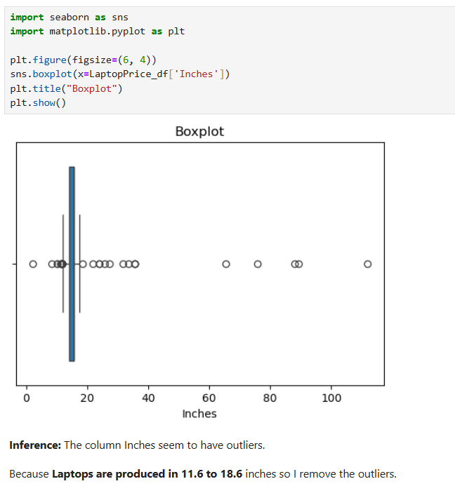
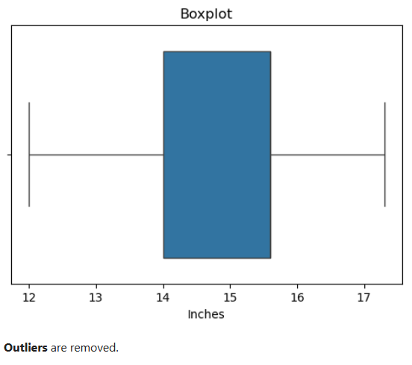
Checking Outliers
Outliers are unusual values that don’t fit the general pattern of the data. Handling them properly ensures meaningful insights.

Slide 10
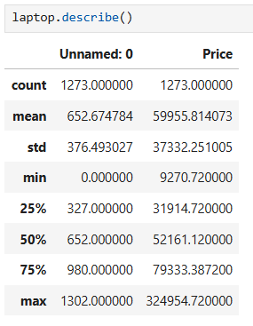
Descriptive Analysis

Slide 11
Data Visualization
Data visualization is a key part of Exploratory Data Analysis (EDA) that helps transform raw data into meaningful insights through graphs and charts. In this project, visualizations are used to study laptop prices, specifications, and brand performance.
Univariate analysis
Bivariate analysis
Multivariate analysis

Slide 12
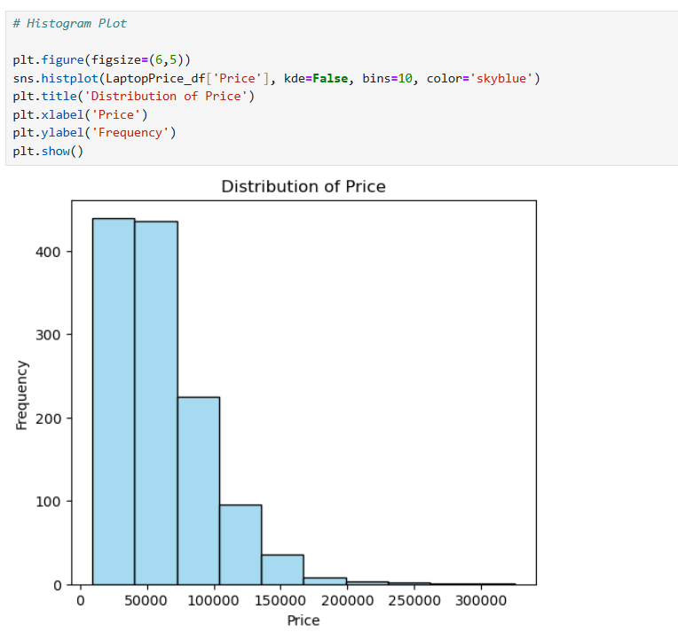
Univariate Visualization

Slide 13
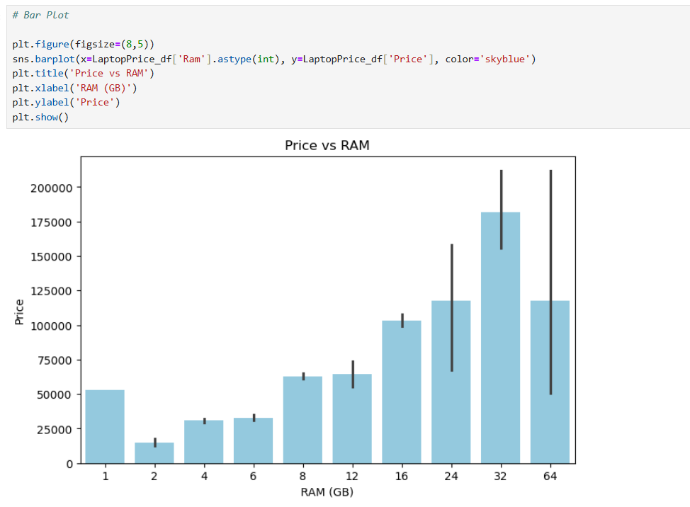
Bivariate Visualization

Slide 14
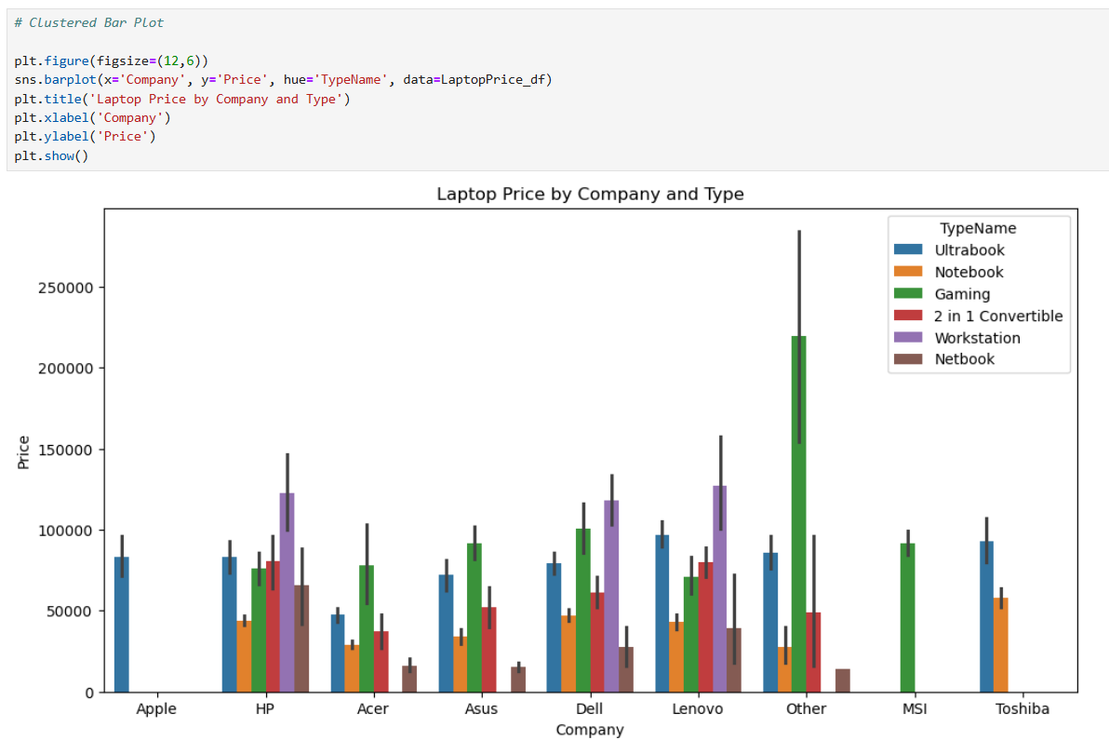
Multivariate Visualization

Slide 15
Insights Obtained
Laptop prices range from Rs.9k to Rs.3.2 lakh.
laptops are highly sold between 0 to 1 lakh and very low sold laptops are between 2 lakhs to 3 lakhs.
Lenovo, Dell and HP is highly Saled and lowest is Apple.
32GB RAM was mostly sold laptops and most lowest is 2GB RAM laptops.
Windows 10 is the most high priced devices to campare then other operating systems and lowest is Linux, Chrome OS, No OS, Android.
Operating systems: majority use Windows, followed by Mac OS (Apple). Linux/No OS laptops are cheaper.
Brand premium: even with similar specs, Apple and MSI laptops cost more compared to Acer, Dell, or HP.

Slide 16
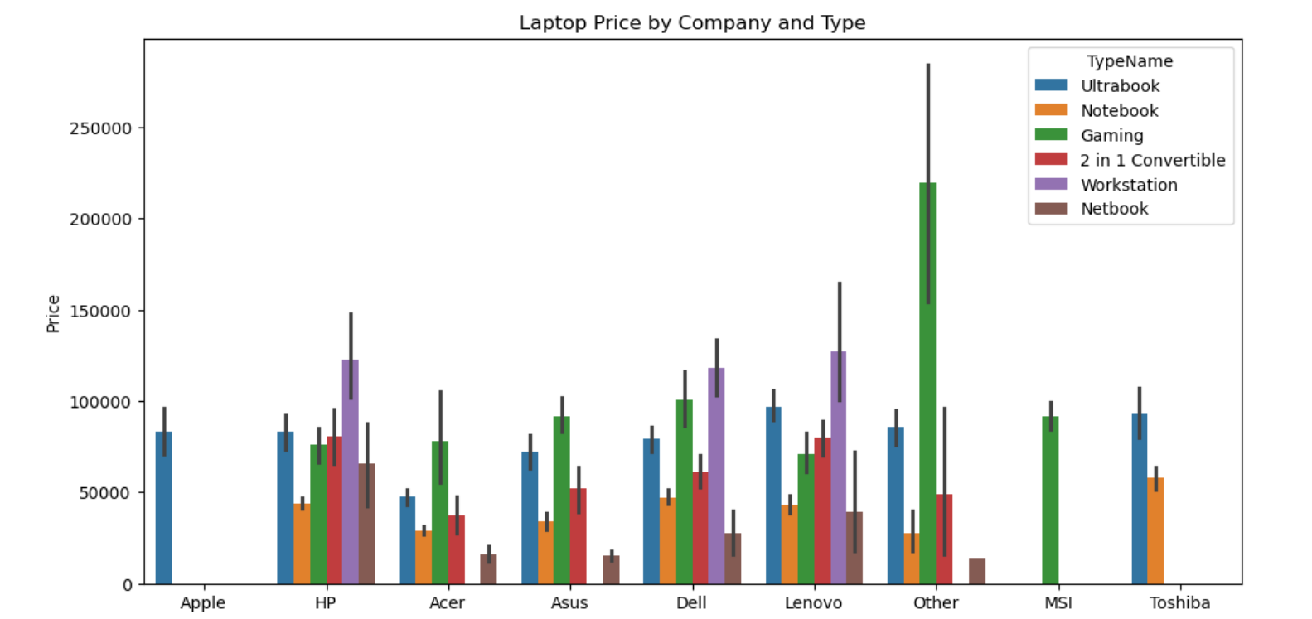
Recommendations

Slide 17
Thank You

